Slide 1
Neff’s Creek Flood Mapping Study
An Introduction – May 2016, (Revised June 2019)

Slide 2
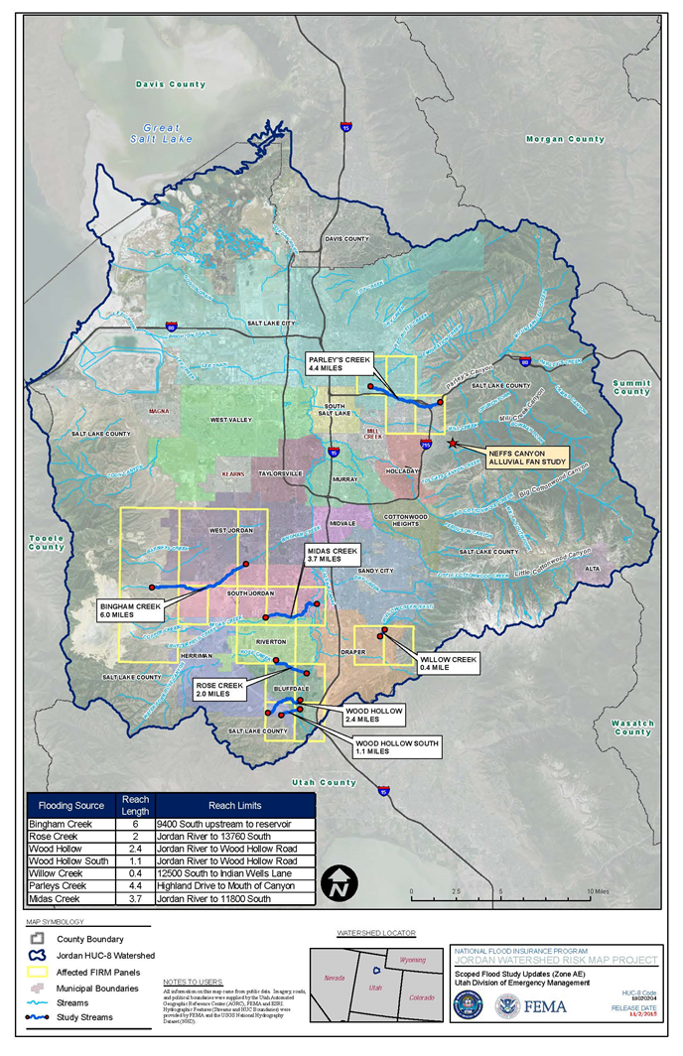
Tonight’s Agenda
Introduce the Neff’s Creek Flood Mapping Study, and the technology and methodology behind the study
Help you identify and understand your community’s flood risk
Share the path forward – our timeline and process for rolling out the map for the Neff’s Creek community
Notes:
Jamie:

Slide 3
Assessment of the Situation
Tonight’s goal:
Move from Low Understanding,
Less Preparedness
to
High Understanding,
More Preparedness
Notes:
Jamie
Flood risk can and does change over time due to different reasons. However, in the case of Neffs Creek, the risk was always there, but was never mapped appropriately based on this risk.
Currently, there is a low understanding of the true risk, based on the current maps provided for the area. With a low understanding of the risk there is not a need to take steps to prepare.
Our goal today is to provide a better understanding of the risk, based on updated information using the best available technology in order for residents and property owners to take steps to become more prepared when minimizing their risk to flooding.

Slide 4
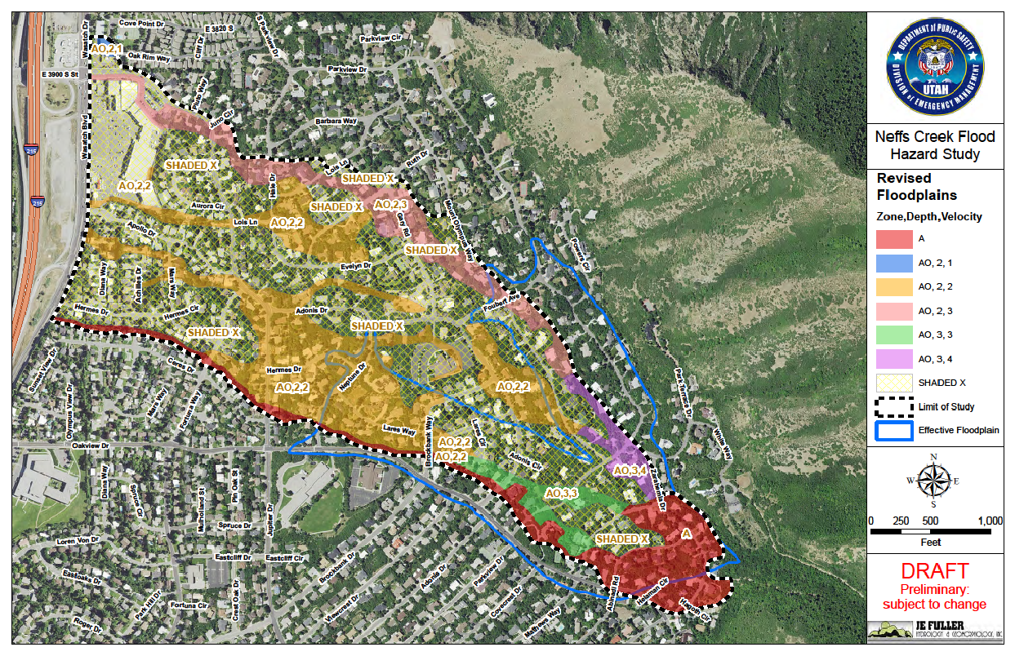
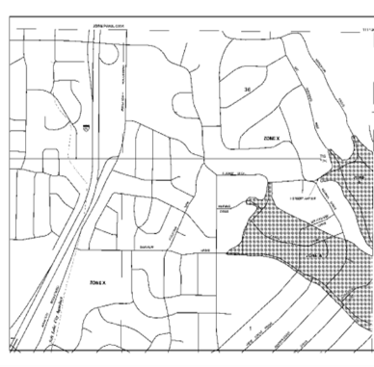
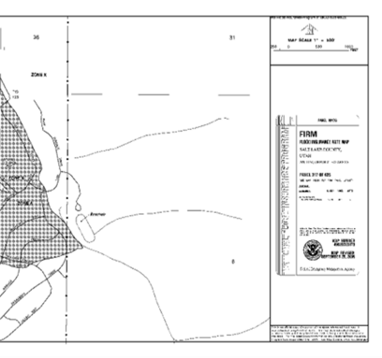
Neff’s Creek Flood Mapping Study Current FIRM vs. Updated Study
Salt Lake County
FEMA FIRM Panel 317
Salt Lake County
FEMA FIRM Panel 316
Notes:
Jamie
Key Message: The risk was always there.
Risk identified, little data, less preparation Vs. Risk identified, more data, improved preparation

Slide 5
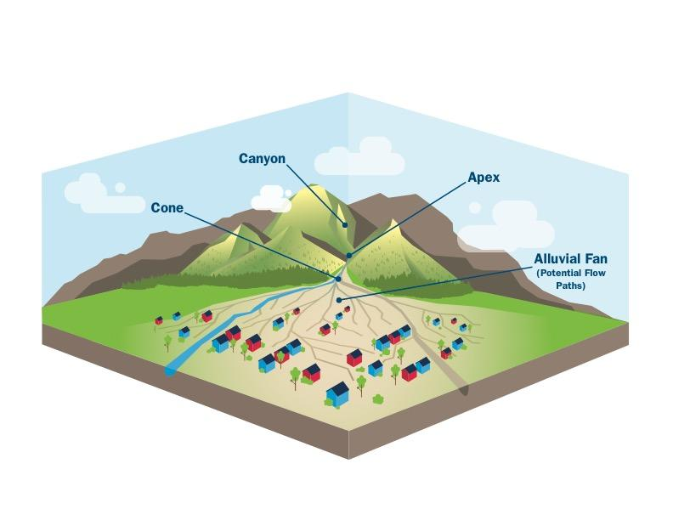
What is an Alluvial Fan?
“Fan”- shaped area where silt, sand, gravel, boulders and woody debris are deposited by rivers and streams over a long period of time.
Flood hazards
Braided, unpredictable flow paths
High-velocity flow
Erosion and scour
Sediment transport and deposition
Debris flow
Mud flow
Flash flooding
Sheet flow
Flood Insurance Rate Map (FIRM) will reflect new and updated flood zones
Notes:
Jamie

Slide 6
Neff’s Creek Flood Mapping Study
Mike Kellogg, JE Fuller Inc.

Slide 7
Overview - Neff’s Creek Flood Mapping Study
Effective FEMA Floodplain
Landform Assessment
Neff’s Creek Study Methodologies
Neff’s Creek Study Results

Slide 8
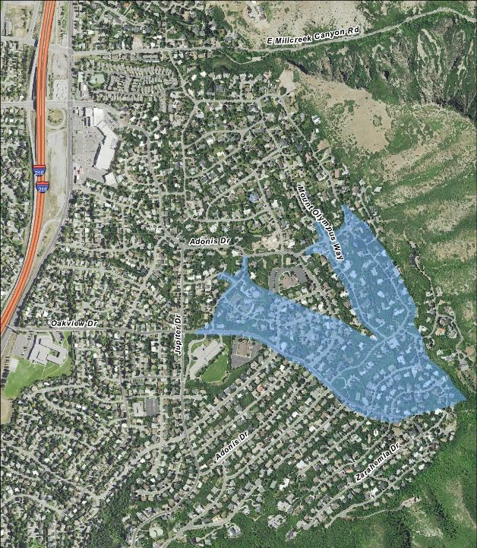
Effective FEMA Floodplain
Approximate A Zone
From the 2012 FEMA Flood Insurance Study for Salt Lake County:
“The depth and extent of approximate flooding from Neff’s Canyon was determined from field reconnaissance, review of topographic data, and engineering judgment.”
Effective Floodplain Does Not Reflect the True Flooding Hazard

Slide 9
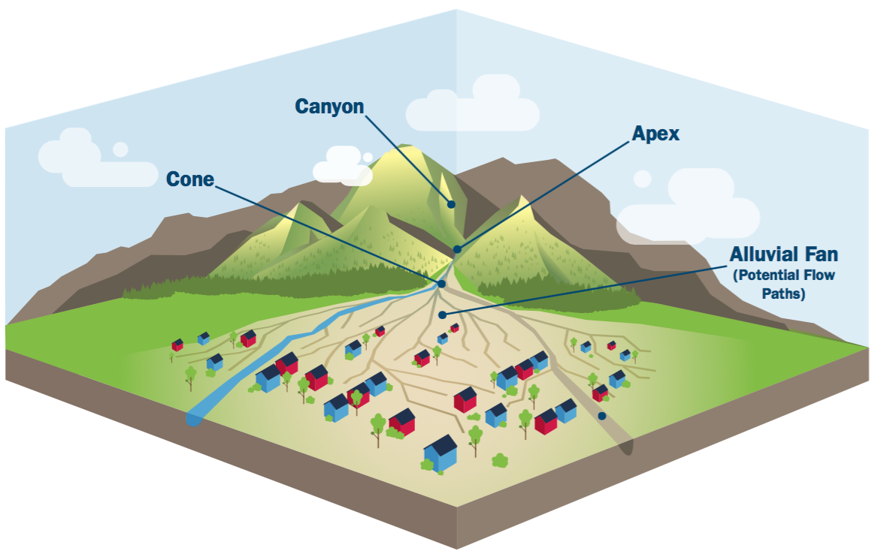
Landform Assessment
The first step of any FEMA flood mapping study is to determine the type of landform
The Neff’s Creek project study area is an Alluvial Fan landform
Alluvial Fans are found on the slopes between the mountain front and the valley bottom

Slide 10
Neff’s Creek Flood Mapping Study
FEMA-specific requirements for Alluvial Fan landforms
Neff’s Creek Study – Used the latest technology and methodology
Two-Dimensional Computer Modeling
Recent Topography
Previous Studies
U.S. Geological Survey Mapping
Salt Lake County Studies
Utah State Study - 1974

Slide 11
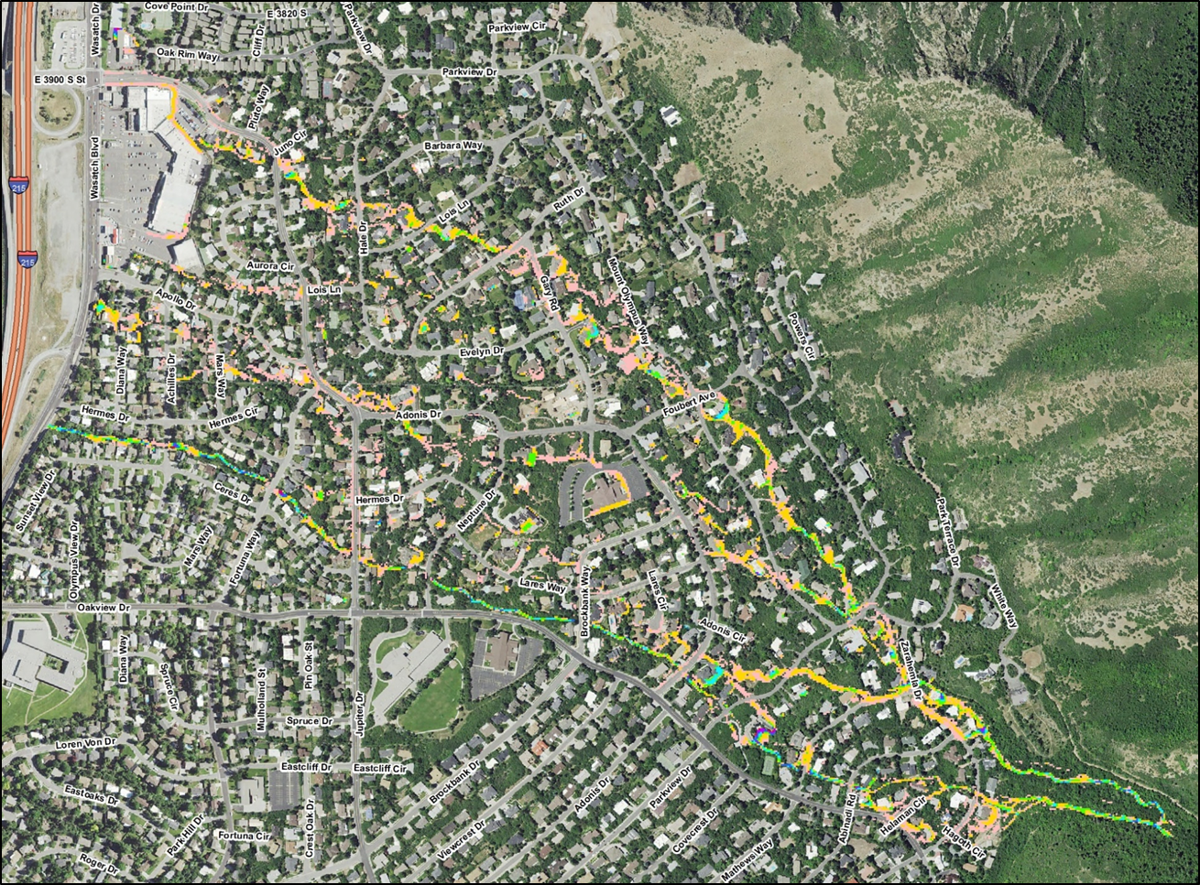
Neff’s Creek Flood Mapping Study
Study results reflect the flood hazard potential for the Neff’s Creek watershed
Base Flood Risk

Slide 12
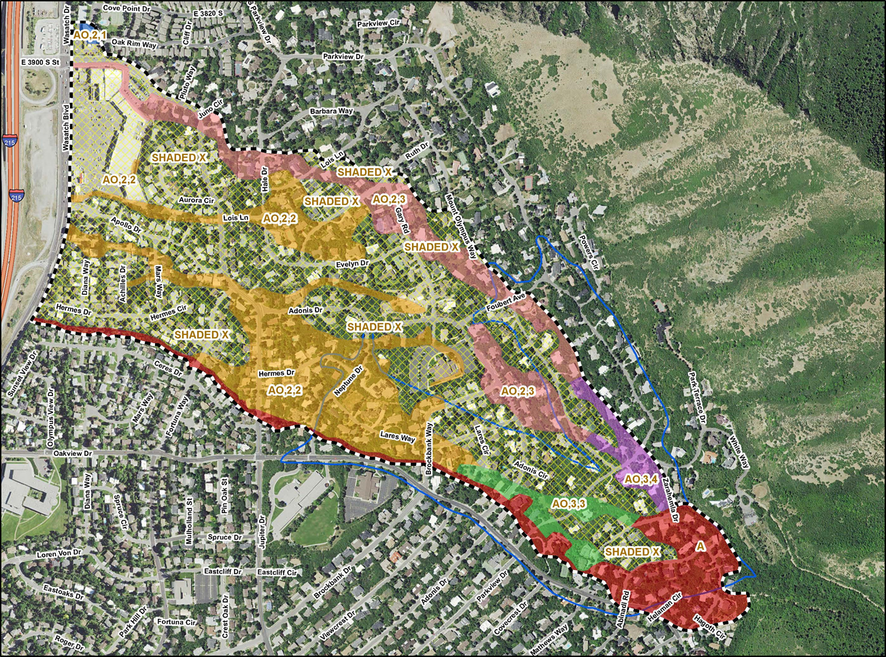
Neff’s Creek Flood Mapping Study
Proposed revised FEMA floodplains

Slide 13

Proposed Revised FEMA Floodplains
FEMA-Based Flood Hazard Designation | Description
Zone X (shaded) | 100-year flow depth between 0.5’ and 1.0’.
Zone A | Ultrahazardous zone near the alluvial fan topographic apex. Area subject to the highest degree of flowpath uncertainty. In other areas where the average flow depths are greater than 3 feet. Approximate 100-year floodplain.
Zone AO2,1 | 100-year flow depth between 1.5 foot and 2.5 feet. Average flow velocities of 1 foot/second.
Zone AO2,2 | 100-year flow depth between 1.5 feet and 2.5 feet. Average flow velocities of 2 feet/second.
Zone AO2,3 | 100-year flow depth between 1.5 feet and 2.5 feet. Average flow velocities of 3 feet/second.
Zone AO3,3 | 100-year flow depth between 2.5 feet and 3.0 feet. Average flow velocities of 3 feet/second.
Zone AO3,4 | 100-year flow depth between 2.5 feet and 3.0 feet. Average flow velocities of 4 feet/second.

Slide 14
What’s Next?

Slide 15
Common Questions Related to New Maps
Flood Insurance
Floodplain Development
Timeline
What can property owners do to mitigate risk from flooding?
What can the community do to reduce flood risk?
Questions Specific to Millcreek
Historical Structures

Slide 16
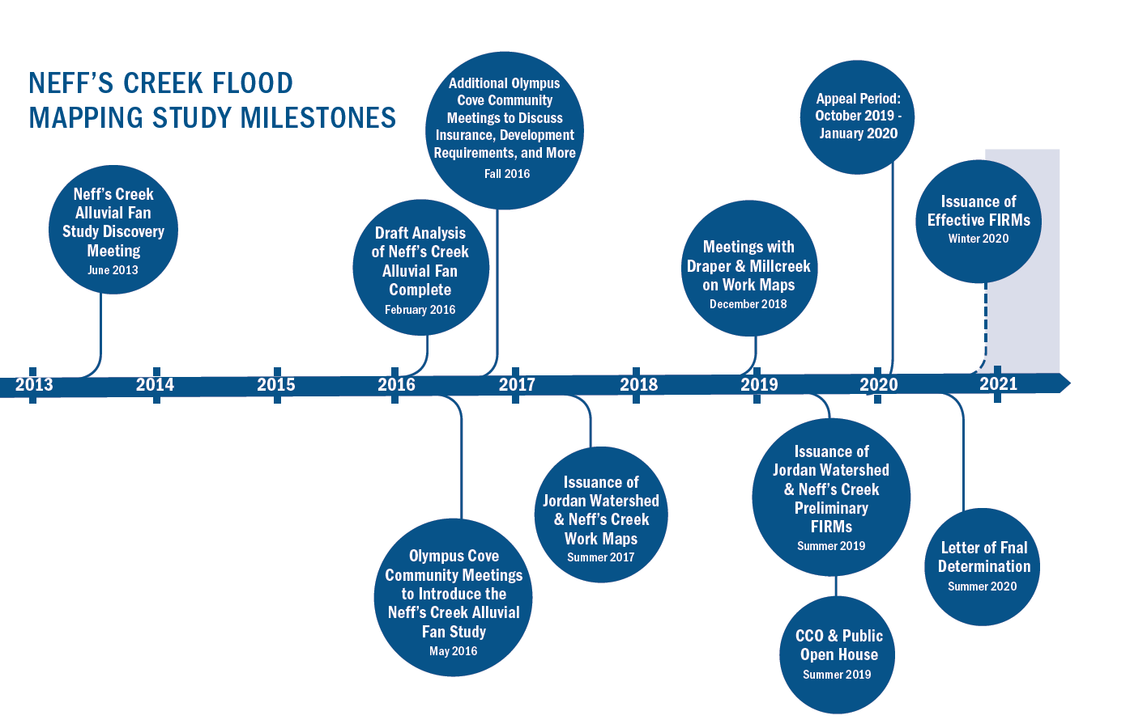
Neff’s Creek Flood Mapping Study Timeline & Next Steps
Projected dates based on current timeline
Note: If appeals are received effective date will be delayed.
Notes:
Jamie

Slide 17
Upcoming Community Meetings
Preliminary Flood Isurance Rate Map (FRIM) Open House – Summer 2019(TBD)
Additional focused meetings if needed – TBD
Notes:
Jamie

Slide 18
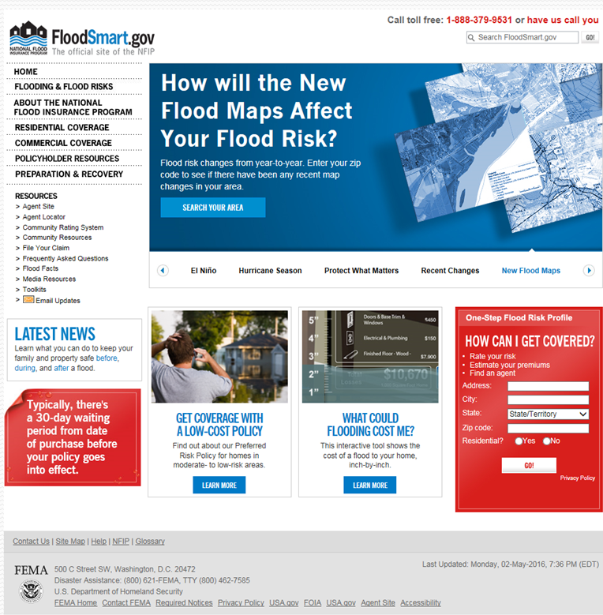
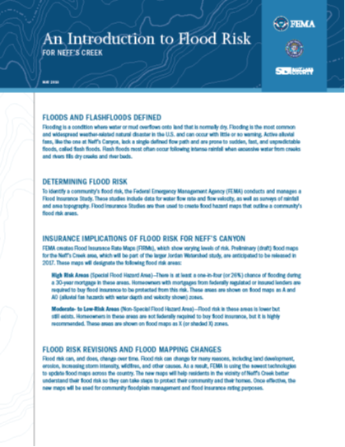
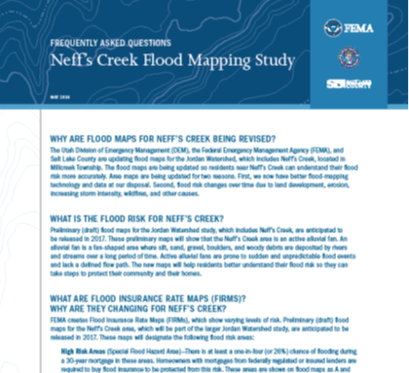
How Can I Learn More?
Neff’s Creek Flood Mapping Study Webpage: https://slco.org/flood-control/neffs-creek-floodplain/
FloodSmart.gov https://www.floodsmart.gov/floodsmart/
FEMA Website http://www.fema.gov/
Notes:
Jamie

Slide 19
Questions and Conversations
Please join us in the foyer for conversations with the following subject experts regarding:
Property Location
Risk Information
Technical Study/Engineering
Flood Insurance
Floodplain Management
Flood Preparedness
And more…
Notes:
Jamie

Slide 20
Thank You for Coming
Please visit the Neff’s Creek Floodplain webpage for updated information
https://slco.org/flood-control/neffs-creek-floodplain/
Notes:
Jeff/Kade

